Slide 1
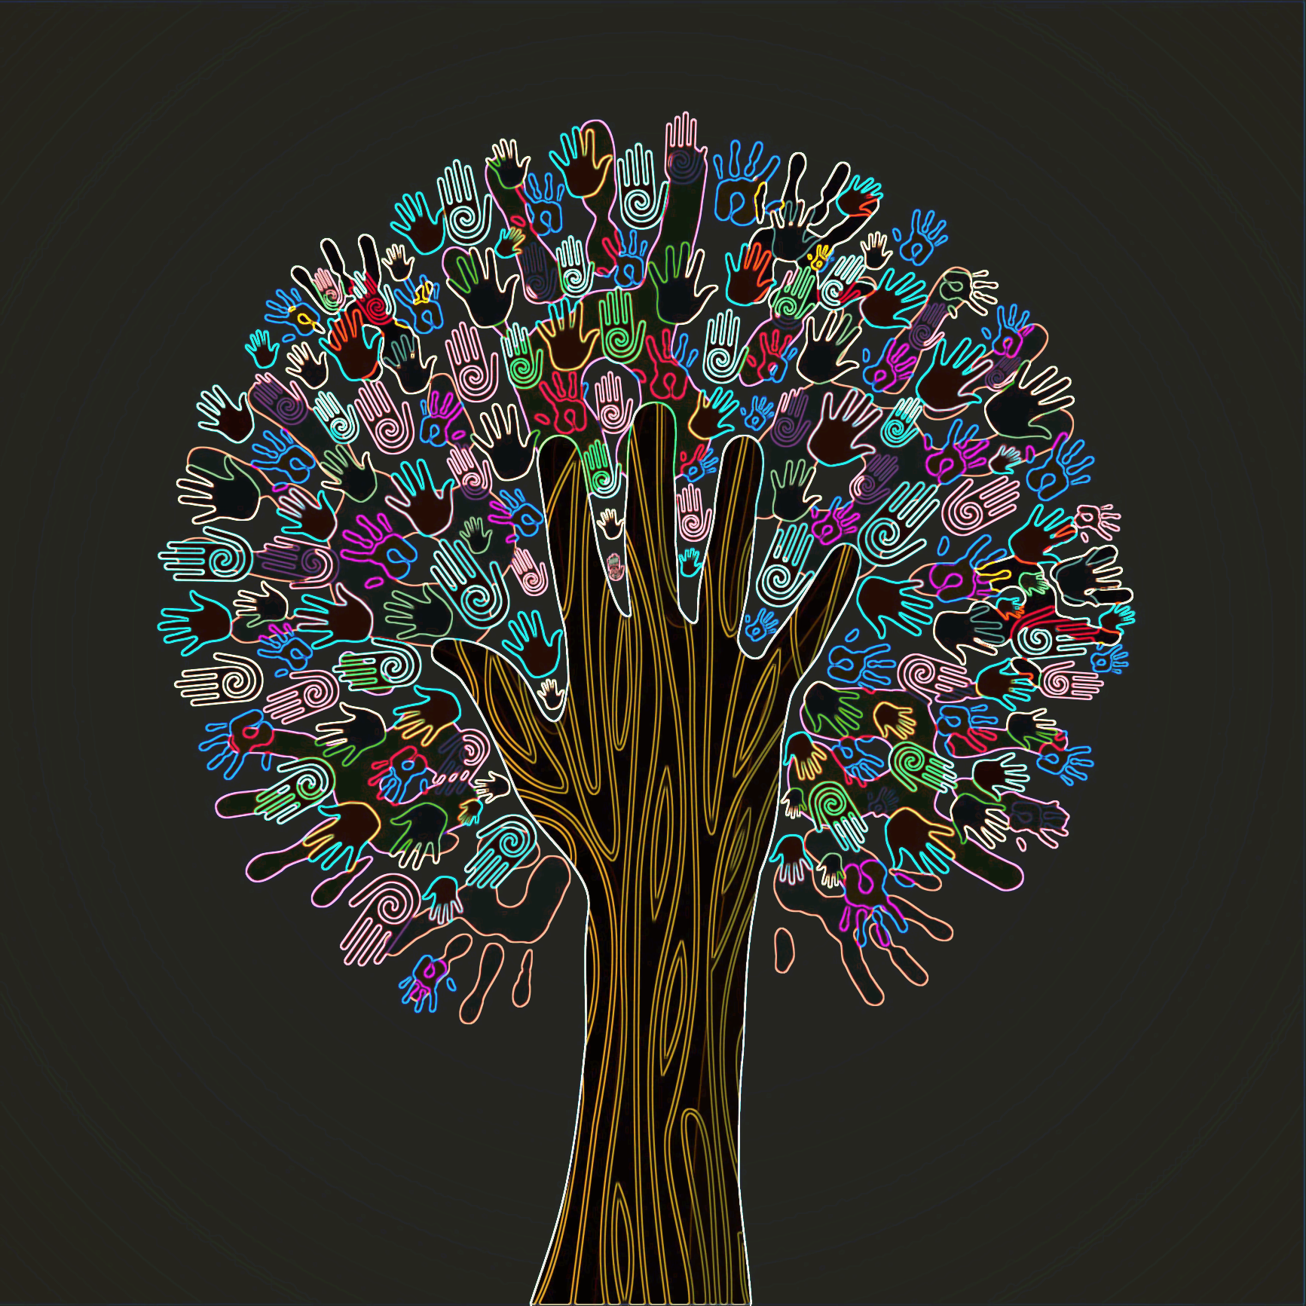

Using CHILDES to Explore Early Moral Language (and More?)
Jennifer Cole Wright
Department of Psychology
College of Charleston

Slide 2

PLAN FOR TALK
Discuss two different studies conducted using the CHILDES database.
  Case study of two children’s early moral language
  Follow up study investigating children’s early use of thin moral concepts
  If time allows: mention of third
    Children’s exploration of moral concepts through pretend play
Q&A re: the CHILDES databases/ programming options for potential future research ideas.

Slide 3
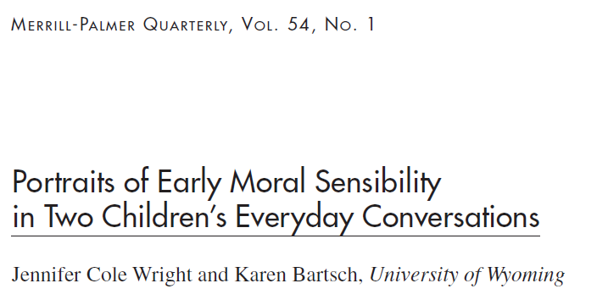
Study 1
(2008)

Slide 4
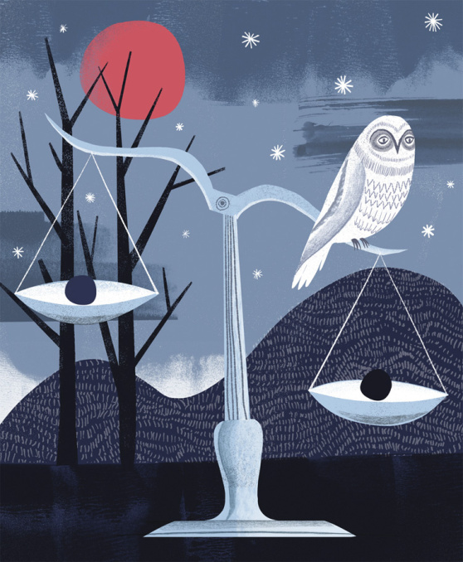
Questions of interest:
What moral issues do young children notice and talk about (e.g., feelings, welfare/needs, rules/standards, obedience, principles)?
How do they engage in conversations about moral issues
  i.e., do children introduce moral issues for discussion or simply respond to adult leads?

Slide 5
Questions of interest:
What sorts of “moral” words (e.g., good, bad, right, wrong) do young children use?
How do they use them (e.g., to disapprove, to ask for reasons, to elicit sympathy)?

Slide 6
Questions of interest:
And finally, do children’s moral arenas change over time?

Slide 7

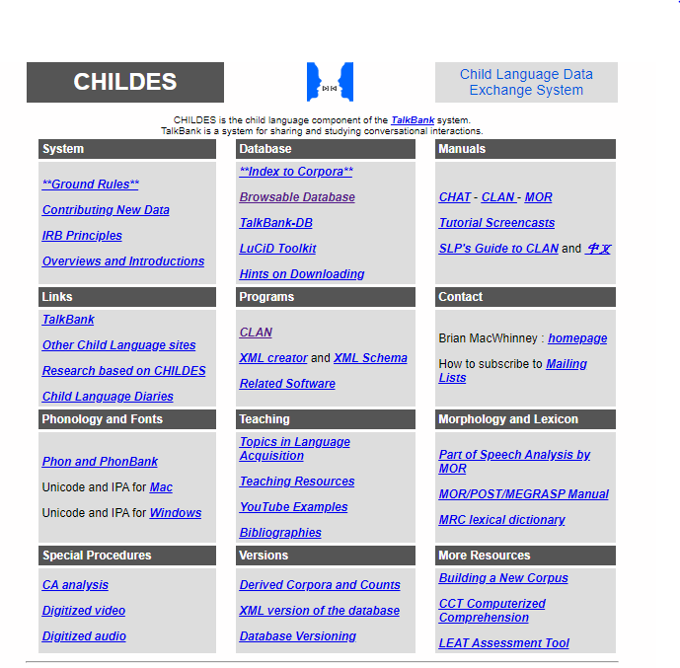
CHILDES database https://childes.talkbank.org/
A collection of natural language transcripts contributed to by numerous researchers.

Slide 8
Identifying relevant samples

Slide 9
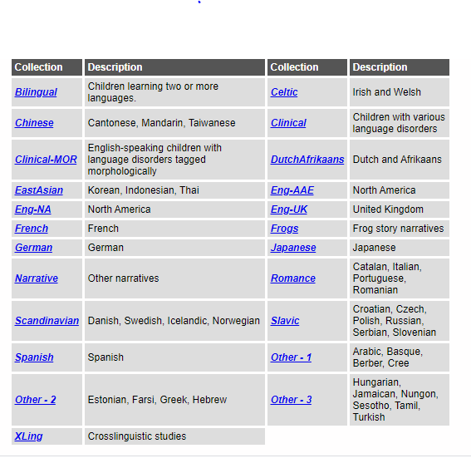
Identifying relevant samples

Slide 10
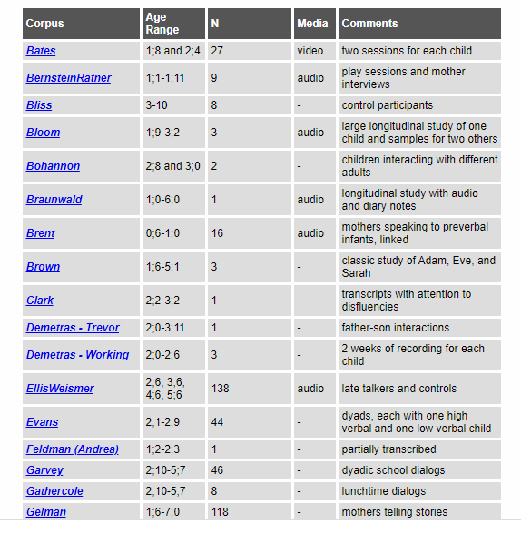
Identifying relevant samples
https://childes.talkbank.org/access/Eng-NA/Brown.html

Slide 11
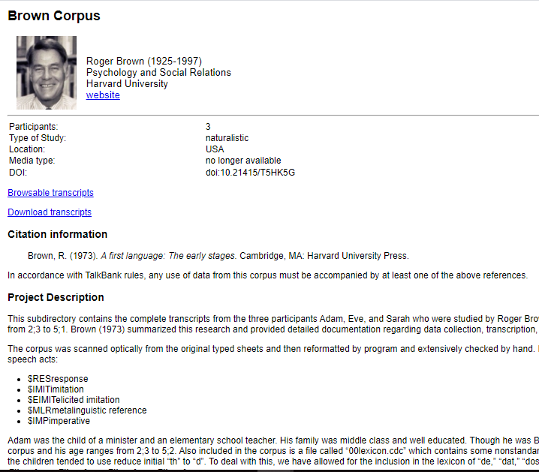
Identifying relevant samples

Slide 12
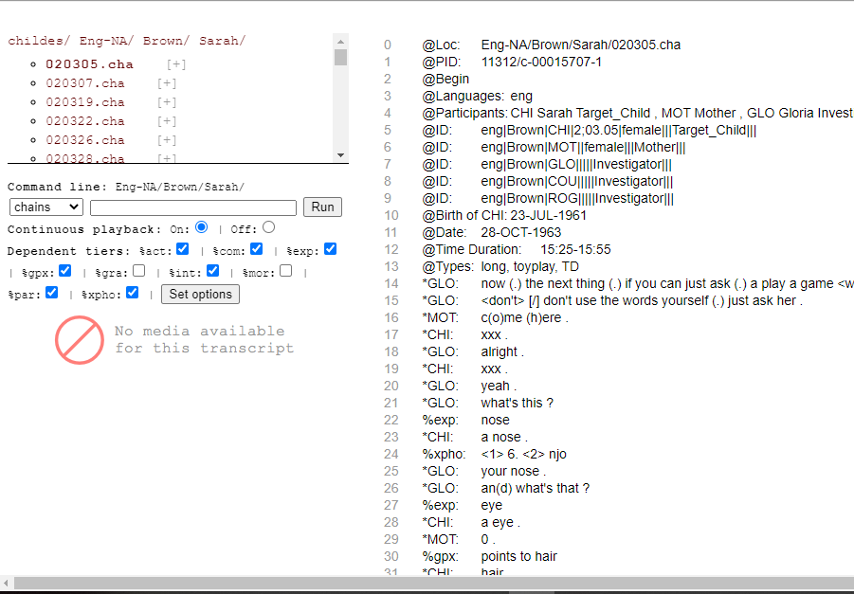
Identifying relevant samples

Slide 13


We selected two children who were
  native English speakers
  transcripts contained primarily parent/child (as opposed to researcher/child) at-home conversations
  representing children as they aged from 2 years to 5 years

Slide 14
  Abe’s corpora included
    210 transcribed audiotaped at-home conversations
    recorded by Abe’s father between 1973-1975
    1 hour/week from 2.4 years – 4.0 and 1/2 hour/week from 4.1 – 5.0.
  Sarah’s corpora included
    139 transcribed audiotaped at-home conversations
    recorded by researchers present on site between 1963-1966
    for 1/2 hour once or twice a week from 2.3 years- 5.1.

Slide 15
Both children were:
  only children
  Caucasian
  From middle-class families
Sarah’s transcripts had a lower child-to-adult talk percentage than Abe
  Sarah: child 35%/adult 65%
  Abe: child 57%/adult 43%
Sarah and Abe differed in the mean length of utterance (MLU) at
  33-36 months (2.3 vs. 6.0, respectively)
  45-48 months (3.2 vs. 8.0)
Notes:
Mean length of utterance is a measure of linguistic productivity in children. It is traditionally calculated by collecting 100 utterances spoken by a child and dividing the number of morphemes by the number of utterances. A higher MLU is taken to indicate a higher level of language proficiency.

Slide 16
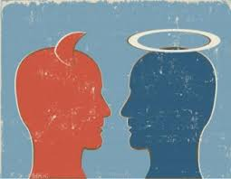
Defining moral conversations
As our primary aim was to describe the breadth and depth of two individual children’s early moral sensibility, we assumed a broad definition of morality.
We chose target words that would index conversations involving reference to:
  the wellbeing of (or harm to) individuals, animals, and/or objects
  people’s qualities/dispositions/actions related to such wellbeing (or harm)
  rules/expectations/reasons for/feelings about such issues

Slide 17
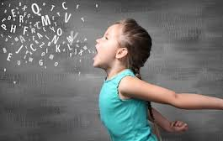
Selecting words
We searched for target words by reading samples of transcripts for three children (ages 2 – 5 years)
  Abe ( Kuczaj, 1976) 185 pages
  Adam (Brown, 1973) 287 pages
  Nathan (Snow, 1990) 240 pages
Transcripts reflecting one month of recorded discussion within each six-month period were reviewed
Conversations pertinent to moral issues were noted uses of key moral words (e.g., good/bad, right/wrong, nice/mean, friend, etc.) were identified.
Notes:
Mean length of utterance is a measure of linguistic productivity in children. It is traditionally calculated by collecting 100 utterances spoken by a child and dividing the number of morphemes by the number of utterances. A higher MLU is taken to indicate a higher level of language proficiency.

Slide 18
Selecting words
This resulted in a list of potential target moral words, to which we added other words encountered in moral development studies and children’s literature, as well as a few suggested by colleagues.
The resulting list contained 98 potential target words.
We conducted frequency analyses of child and adult uses of all forms of each word (e.g., love/loved/loves/loving). Words not employed in either set of transcripts were dropped from the target word list.
The final list consisted of 77 words, which were used 12,343 times across both sets of transcripts.
      Full list available in appendix of article

Slide 19
Selecting words
The target words were grouped (though not exclusively) into the following categories:
  words indicating moral evaluation (e.g., good, bad, right, wrong)
  moral (deontic) expectations/obligations (e.g., should, must, rule);
  moral emotions/internal states (e.g., love, sympathy, shame)
  moral actions (e.g., hit, hurt, help)
  moral traits/virtues (e.g., brave, gentle, honest)
  other (e.g., war, peace, gift).

Slide 20
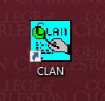
Target word excerpts
We used CLAN to generate conversation excerpts (conversation windows centered on the target word line) involving adult and child uses of the 77 target words
Preliminary coding established a 5-line window as sufficient for coders to accurately identify target words being used in moral contexts.
  Abe: he got yellow feet.
  Father: that’s right . . .the camel has yellow feet.
  Abe: and toes I don’t wan(t) (t)a hurt him.
  Father: ok . . .you don’t have to hurt him Abe . . .the alligator which the donkey kicked is crying tell me who’s crying.
  Abe: alligator’s crying.

Slide 21
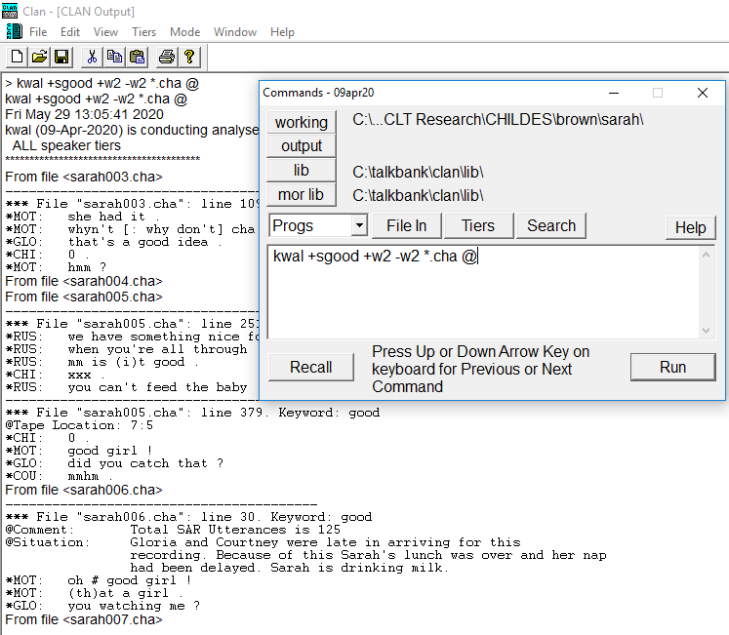
Pick location of database files
Command line
Conversation excerpt
kwal +t*CHI +sgood +w2 -w2 *.cha @
Source location

Slide 22
Coding scheme
Speaker: Who used the target moral word
Use: Characterization of how the moral conversation was employed. The coding options, not mutually exclusive, were to:
  (a) instruct/model
  (b) approve/disapprove
  (c) give/ask for reasons
  (d) motivate/confirm/deny obedience
  (e) communicate feelings
  (f) motivate/engage in perspective-taking
  (g) elicit/express sympathy

Slide 23

Coding scheme
Reference: What topics and situational features the speaker explicitly indicated were of moral relevance. The coding options, not mutually exclusive, were:
  (a) feelings of speaker (b) feelings of another
  (c) welfare/needs of speaker (d) welfare/needs of another
  (e) disposition/behavior of speaker (f) disposition/behavior of another
  (g) damage to goods/property (h) principles
  (i) (dis)approval of speaker (j) (dis)approval of another
  (k) laws/rules/standards (l) obedience/ punishment

Slide 24
Motivation: distinguishing between appeals to:
internal motivation (e.g., appeals to empathy or conscience)
  (a) the speaker’s own feelings
  (b) the welfare/needs/feelings of others
  (c) a principle, such as justice, fairness, or kindness.
external motivation (e.g., appeals to authority or punishment)
  (a) the approval/ disapproval of others
  (b) laws/rules/standards
  (c) obedience or punishment
  (d) damage to goods/property.
Coding scheme

Slide 25
Child role (passive or active):
To be passive, the child must
  use the moral word directly after the adult in a mimicking fashion
  refer back to the adult in his/her use, or
  otherwise responded directly to some form of instruction from the adult
Active role was coded when the child exhibited
  creative thinking, reflecting a novel use
    for instance, in pretend-play or story-telling that involved moral relevance
  independent reasoning about a moral issue
Coding scheme

Slide 26
Child role (passive or active):
Instances not clearly active or passive were coded indeterminate.
  Initial coding resulted in over a third of instances being judged as indeterminate, so these were re-coded using larger conversation windows (including ten lines above and five below the target word line), which resulted in 90% active/passive judgments.
Coding scheme

Slide 27
Context of use:
context-specific (Abe, 3.6: “where I was throwing rocks across the street. I didn’t hit anybody”)
  non-generic (“my bird flies”) statements
context-general (Sarah, 4.11: “oh Betty’s always bad”)
  generic (“birds fly”) statements
Coding scheme
25% of conversation windows coded by two coders, reliability Cohen’s κ between = .75 - .90

Slide 29
Results

Slide 30
c
Results

Slide 31
Results

Slide 32
Perhaps a function of the so-called “terrible twos” in which the child’s increasing autonomy, mobility, and active participation in family activities brings on sudden bursts of self-assertion and parent-child conflict.
Results

Slide 33
Similarities
Both Abe and Sarah were
  active in discussion of moral issues with adults
  sensitive to numerous considerations that appear to be crucial to the development of moral understanding
They both demonstrated sensitivity to the fact that:
  certain behaviors and situations warranted (dis)approval and reward/punishment
  such behaviors and situations were either good or bad – and, therefore, warranted (dis)approval and reward/punishment – because they involved benefit or harm to another’s feelings, needs/welfare, and overall well-being.

Slide 34
Similarities
In short, they both demonstrated early sensitivity to the moral significance of
  their own dispositions/behaviors
  and the dispositions/behaviors of others
They communicated about the goodness and badness of people, actions, things, ideas, and situations.
  More references were context-specific than general.
They demonstrated a basic understanding of the normativity that grounds moral issues, giving reasons why certain things should or should not happen and why some things ought to be done or not done.
They employed this understanding in their pretend play, creating scenarios with nice or mean characters that engaged in good or bad acts.

Slide 35
Abe’s moral landscape was complex and imaginative.
  Though he engaged in fewer moral conversations than Sarah, his conversations were rich with discussions of feelings and reasons.
  He displayed high levels of sensitivity to the needs and wellbeing of others.
  Abe and his parents appealed to internal motivation more.
Sarah’s moral landscape looked much more “Kohlbergian”
  dominated by egocentric focus on denying or confirming (as well as enforcing) obedience
  and expressing her own (dis)approval of things other people have done or said.
  Sarah and her parents appealed to external motivation as much, if not more, than internal.
Differences

Slide 36
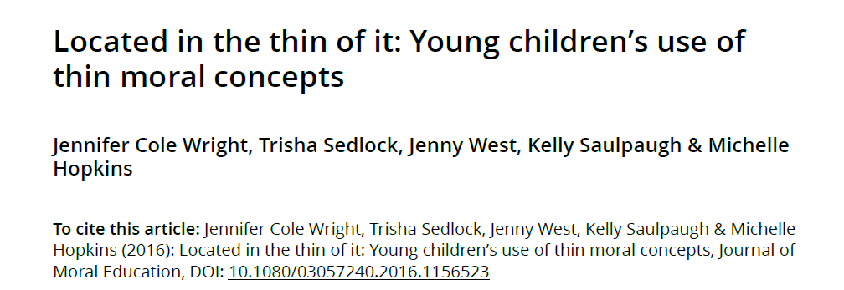
Study 2
(2016)

Slide 37
Two unexpected findings in Study 1
FIRST, use of thin moral evaluative concepts:
Both children and their parents frequently used good and bad to communicate about moral issues, they almost never used right and wrong
  Even though they used both frequently in non-moral evaluations (e.g., wrong shoe, right answer) from the earliest transcripts.
This suggests something interesting about children’s earliest cognitive grasp of the moral domain
  children experience, and are introduced to, moral concerns as being more closely tied to desires, feelings, and values (good/bad) than to rules/standards, correctness, and obligation (right/wrong).

Slide 38
Two unexpected findings in Study 1
Children’s early conceptual grasp of the moral domain may be grounded in aretaic—rather than deontic—concepts.
  HYPOTHESIS: A larger sample will confirm this use of value concepts (good/bad) more frequently than deontic concepts (right/wrong) for moral evaluation.
SECOND, developmental decline:
Both children’s and their parents’ use of moral concepts spiked at age 2, rapidly declining after that through the age of 5.0 years old.
  HYPOTHESIS: That the frequency of the use of both sets of concepts for moral evaluation would be greatest at 2.0 years and would decrease from there.

Slide 39
Thin moral concepts
Philosophers discuss the definitional priority of thin moral concepts over other moral concepts, which depend upon them for their moral status.
  being mean is morally sanctioned because it is bad (or wrong)
  being nice is morally praiseworthy because it is good (or right).
The key point is that, conceptually speaking, moral evaluation starts with and ultimately returns to thin moral evaluation—to people, things, and actions being good, bad, right, or wrong.
Thus, thin concepts may serve as the conceptual foundation of children’s earliest understanding of the moral domain, making these concepts worthy of investigation.

Slide 40
These concepts are not exclusive to the moral domain, but are broadly used for non-moral evaluation (e.g., good cookie, right answer) as well—whereas other concepts (e.g., cruel, brave) are not.
Given that young children’s earliest encounters with evaluation are likely non-moral (e.g., something tasting good; something feeling bad), these concepts may serve as an early bridge from the non-moral into the moral domain
  children begin to learn that things can be good/bad or right/wrong for a variety of reasons, some of which (e.g., hurting or helping someone else) have moral significance.
Thin moral concepts

Slide 41
Transcripts
CHILDES databases for:
  14 children (8 boys and 6 girls, 12 U.S. families and 2 British families)
Children selected to match Study 1 sample.
  English speaking
  Involve conversations that occurred at the child’s home (rather than a research lab)
  Dominantly composed of child/parent (rather than child/researcher) conversations
  Collected periodically over a span of time between the ages of 1 to 5 years old

Slide 42
Transcripts

Slide 43
Coding excerpts
Searches for use of the four target evaluative concepts (good, bad, right, and wrong) were conducted, generating conversation window
  We used a 7-line window (3 lines above and 3 below) to provide additional context for identifying target concepts as being used for either moral or non-moral evaluation.
File "adam03.cha": line 1474. Keyword: good
  *CHI: play toy up.
  *CHI: play toy up.
  *MOT: <pick the play toys up>.
  *MOT: that's a good boy.
  *CHI: good boy.
  *CHI: one # two.
  *CHI: ok.

Slide 44
Moral vs. non-moral evaluation
We read through each excerpt and distinguished between moral and non-moral uses of the target concepts in parent/child conversations.
In order for each concept’s use to count as moral, it had to have been used for:
  the evaluation of physical or psychological/emotional harm, injury, or hurt caused to self or others—also, harm to objects (Kagan, 1981)
  discussions of prosocial or antisocial behavior
  demonstrations of caring, concern, empathy for others (person, animal, or object)
  discussions of upholding obligations (following rules, keeping promises, doing what is expected, etc.) and meeting social expectations/norms.

Slide 45
Coding scheme
Speaker: adult (parent) or child
Use: the goal of the moral evaluation being performed
Reference: the topics, characteristics, and/or features of the situation the speaker was either morally evaluating or referencing as the source of the moral evaluation
  NOTE: In this study we teased apart the reference to “dispositions” (internal psychological states” and “behavior”
25% of conversation windows coded by two coders, reliability Cohen’s κ between = .86 – 1.00

Slide 46
COCA – Adult Sample
One possible explanation for the asymmetry of thin concept use observed in Study 1 is that it reflects a general pattern of use at the population level.
  To explore this, we sampled the use the four concepts in the Corpus of Contemporary American English (COCA; Davies, 2003), an online resource of spoken (e.g., radio sources, TV) and written English (e.g., fiction, popular magazines, newspapers, and academic texts) in the U.S., covering 1990-2010.
Randomly selected 1,000 uses for each concept from the database
  We coded them for moral/non-moral status, using the same criteria as above.

Slide 47
18,024 instances of the four evaluative concepts:
  4,779 instances of good:
    9.4% moral (14.4% by children, 8.4% by adults)
  571 instances of bad:
    59.5% moral (72.5% by children, 50.4% by adults)
  12,166 instances of right:
    0.1% moral (0.1% of the time by both)
  508 instances of wrong:
    3.1% moral (1.5% by children and 3.8% for adults)
Results

Slide 48
Parents used the evaluative concepts in conversation twice as frequently as their children. But, the children used the concepts for moral evaluation more frequently than their parents.
Both children and their parents used the value concepts (good/bad) more frequently than the deontic concepts (right/wrong) for moral evaluation
  Even though all but two of them (Emily and Seth) used the deontic concepts more frequently in non-moral evaluative contexts.
Results

Slide 49
Results

Slide 50
Results

Slide 51
Found the same developmental trend as Study 1.
This decline could reflect that children’s overall utterances increased over time at a higher rate than their moral utterances
  this would not account for a similar pattern in their parents, whose overall utterances over time remained relatively stable.
More likely a reflection of “terrible twos”: increasing autonomy, etc. resulting in the need for more frequent conversations about moral boundaries.
Or, given the paucity of parent/child references to standards/expectations/rules and obedience/punishment, it may be that young children’s newfound conceptual/linguistic tools for expressing their moral awareness—and/or parents’ desire to cultivate this awareness—simply creates an environment for early discussion that gradually becomes less central in daily parent/child discussions.
Results

Slide 52
Results

Slide 53
These findings suggests that the bridge children first encounter between the non-moral and the moral domains is one that involves their connection to, and concern for, values.
  Morality is essentially about people, behaviors, thoughts, ideas, and things that are good/bad for themselves and others, that produce good/bad outcomes, that possess good/bad qualities.
Given that by two years of age, young children are already becoming adept at navigating a world comprised of needs, desires and feelings (early TOM) this entry into the moral domain seems a natural one.
Results

Slide 54
It is also worthy of note that good and bad can be qualities of people, animals, objects, and events (e.g., good/bad boy, good/bad deed, good/bad idea) in a way that right and wrong cannot be
  right/wrong are most commonly qualities of actions/outcomes (e.g., we don’t speak of someone as a right/wrong girl, but we do speak of her right/wrong actions).
Value concepts may provide young children with the linguistic flexibility to appreciate the moral importance of both qualities of people and their internal states (e.g., emotions/ intentions), as well as actions (and their outcomes).
Results

Slide 55
Results
Strong focus on the internal psychological states and behaviors of others
  at the same time much less explicit reference to standards, expectations, and rules.
The goodness/ badness of certain kinds of actions requires referencing norms:
  e.g., “you need to raise your hand in class before talking because your teacher wants you to or because that’s the rule”
But children and their parents most frequently evaluate the goodness/badness of morally-relevant behaviors as being directly connected to:
  the internal states that cause them (e.g., “he hurt the puppy because he was a bad man”)
  the outcomes that they cause (e.g., “sharing your toys was good to do because it made all the other children happy”).

Slide 56
This provides support for the view that young children make clear distinctions between:
  conventional transgressions (e.g., failing to raise one’s hand before talking), whose wrongness is grounded by the existence of “authority-dependent” norms/rules
  moral transgressions (e.g., hitting another child), whose wrongness is grounded by (unchangeable) “authority-independent” characteristics/features (e.g., harm caused) of the situation
Results

Slide 57
Children evaluated the moral significance of internal psychological states more frequently than external behaviors/outcomes.
Despite early research on young children’s moral development that emphasized a preferential focus on behaviors/outcomes over internal states (like intentions), these findings support the idea that for young children the moral domain involves as much their own and other people’s internal states as it does their observable behaviors and their outcomes.
Results

Slide 58
How can we explain young children’s and their parents’ failure to employ right and wrong for moral evaluation?
It may simply be that because these deontic concepts are more tightly linked to the domain of truth/correctness/obligation, they are less readily “translatable” into the moral domain—at least until the development of more abstract moral concepts begins to occur.
It may make more sense to a child that a person’s intentions and actions can be good or bad
  like a box of chocolates is good and a rotten apple is bad
than that they can be right or wrong
  like an answer to a math problem can be right or the spelling of a word can be wrong
Results

Slide 59
Young children have been found to be good deontic reasoners.
  3-4 year old children can pick out instances of rule-violations
    (i.e., an example of a child not doing what they are supposed to be doing)
  even though under identical conditions, they cannot pick out instances of statistical-norm violations
    (i.e., an example of a child not doing what they normally do).
Young children understand the normative nature of rules and are sensitive to whether or not they are being followed.
But this does not require that they grasp the deontic nature of duty or obligation itself.
  They may simply evaluate the violation of a rule in aretaic (value) terms as being something that is bad (something not good, not beneficial, undesirable, etc.), rather than wrong.
Results

Slide 60
In the COCA sample, we found:
  a decrease in the use of bad for moral evaluation relative to our child/parent sample (28.8% vs. 59.5%, respectively)
  an increase in the use of wrong for moral evaluation (20.8% vs. 3.1%)
  an increase in good for moral evaluation relatively infrequently (15.4% vs. 9.4%)
  an increase in right for moral evaluation relatively infrequently (4% vs. 0.1%).
This suggests that adults generally do regularly use deontic-oriented moral evaluation.
  Thus, the parents in the transcripts shifted their use to better fit their children’s awareness?
Results – Adult Sample

Slide 61

Study 3
(UNPUBLISHED)

Slide 62
Pretend play
There are several reasons to view pretend play as an important medium for early moral exploration and discovery.
First, it provides opportunities for positive and negative moral evaluation
  when a caregiver chastises a child for shooting an imaginary gun at others because “we don’t shoot guns, they can hurt people” or praises a child for bathing and feeding their doll because “that’s being a good mommy”.
This is particularly important because, while young children encounter (and create) many opportunities for moral evaluation, pretend play provides opportunities for the evaluation of behaviors children do not normally engage in, such as “playing war” or “feeding babies”, thereby expanding young children’s range of moral experience.

Slide 63
Pretend play
Second, it provides opportunities for moral exploration
  Children take on and explore various “moral themes”,
    fantastical (e.g., being the “brave knight” who is fighting to the villagers from the evil dragon or the “kind prince” who offers food and shelter to the poor people of his kingdom)
    realistic (e.g., being the fire-fighter who risks his life to save someone from a burning house or the nurse who makes people feel better when they are sick).
  Pretend play is a medium within which children can freely create and explore alternative worlds, take on imaginative roles and new identities, and explore the potential outcomes of imagined scenarios. In this way, pretend-play provides opportunities for “moral practice”.

Slide 64
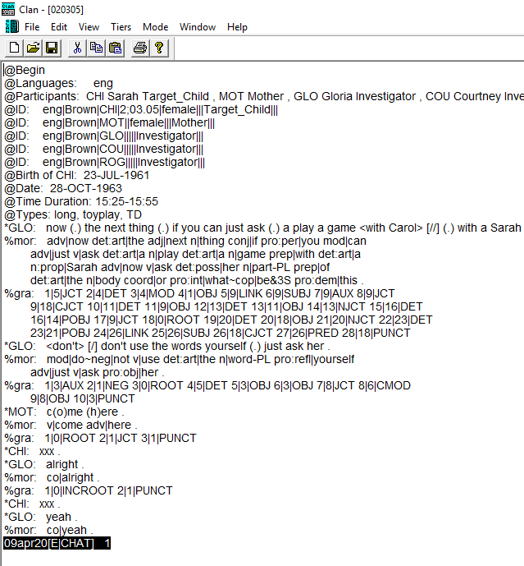
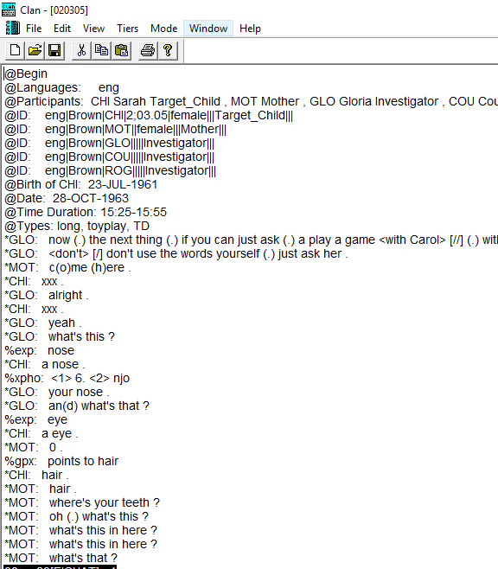
Hide tiers: %mor, %gra

Slide 65
Coding
The participants of this study included 3 males and 3 females.
This study involved two phases of coding.
  First, each transcript was coded for moral conversation and pretend play—with particular interest where they overlapped (i.e., when during pretend play the child and the adult engaged in morally relevant conversation).
  Second, these overlaps were coded for:
    moral evaluation (MEV)
    moral exploration (MEX)

Slide 66
Pretend play
In order for the conversation to be eligible it had to have at least two lines from the child whether or not an adult was involved.
For pretend play, the child could be
  talking about a role they are (“I’m a tiger”) or will be playing such as “I’m gonna be a Cowboy!”, as well as a role someone else is playing “You’re the sheriff!”
  or enacting that role, “Grrr…I’m going to eat you up!”.
The child could imaginatively engage in every-day activities
  either pretending that they are something that they are not (e.g., making believe that banana is a telephone)
  or pretending that they are real when they aren’t (e.g, pretending that the doll is a real baby or the plastic horse is a real horse).
When discussing objects (either real or representations), we didn’t count is as pretend play when the child was merely describing, labeling, or otherwise representing the object.
  The key question we asked was—is the child representing or pretending?

Slide 67
Moral coding
Moral evaluation (MEV)
  When pretend play was evaluated as either “good” or “bad” and this was specific to the child’s behavior.
  For example, if a child was shooting a pretend gun at their parent and the parent commented, “Guns are bad, we don’t shoot guns at people because it might hurt them”, this would be considered moral evaluation of the child’s pretend play behavior.
Moral exploration (MEX)
  The child’s enactment of a morally relevant role or idea
    MEX1 was coded when the child took on a role that had some morally relevant significance that was directly related to the care or harm of others as well as issues of fairness, obedience and defiance or authority relationships.
    MEX2 when the child explicitly pointed out or discussed the moral significance of such roles such as “Mommies love babies” or a violation of these roles such as “bad mommies hurt babies”.

Slide 68
Results

Slide 69

Thank you for listening!

